Slide 1
ECB Council Members’ Objectives and Public Debt at Home
– Evidence from an AI-Based Textual Analysis
Friedrich Heinemann (ZEW Mannheim and University of Heidelberg)
Jan Kemper (ZEW Mannheim and University of Mannheim)
EZB Transparenzmonitor 2025
Mannheim, July 3, 2025

Slide 2
Motivation - THE ECB’s Objective Function
Primary mandate – price stability (Art. 127 (1) TFEU)
But ECB has other objectives too
  Without prejudice to its primary mandate ECB is required to support general economic policies of the EU
De-facto objective function unclear
Notes:
Whatever it takes – PEPP – TPI – Structural asset portfolio

Slide 3
This Paper
  No normative interest
  Empirically describes the objective function of the ECB over time, by country and by speaker
  National public debt and council members’ objectives
    Fiscal dominance hypothesis: high debt – lower interest in primary objective
  Methodology:
    Dictionary approach + LLM text analysis of about 4600 ECB speeches members (1997-2024)
    Regression analysis

Slide 4
ECB objectives
“The primary objective [] shall be to maintain price stability. Without prejudice to the objective of price stability, the ESCB shall support the general economic policies [] as laid down in Article 3 of the Treaty on European Union” (Art. 127 (1) TFEU)
  General economic policies very broad
    E.g. „sustainable development“, „balanced economic growth“, „quality of the environment“
We focus on those six selected explicit and implicit objectives of the ECB:
  Price stability → primary objective of the ECB
  Financial stability → important implicit objective particularly since the financial crisis (e.g. banking supervision)
  Public debt
  Sovereign bond markets
  Climate protection
  Distribution

Slide 5
Data
Speeches dataset (BIS 2024)
  We include only English speeches from executive board members and the national presidents
  Cross-check with ECB and Bundesbank databases

Slide 6
Innovation: LLM
Vorher:
Count relevant words (dictionaries)
Two main dimensions
Prevalence of the objective
  Is the objective mentioned in a speech → 1 or 0
Score
  Positioning of the speaker toward the topic
  Negative, neutral, positive
  For price stability → hawkish (1), neutral (0), dovish (-1) classification
  For other objectives → “hawkish” (1) if ECB should instead focus on price stability, neutral (0), dovish (-1) if ECB should be more active for the other objective.
Advantage of LLM over former text methods
LLM can consider context of a speech instead of identifying single terms
Enables to capture more complex constructs

Slide 7
Prompt
You have a PhD in Economics and are a researcher spealized on monetary policy. Your task is to classify this speech of a member of the European Central Bank Council. Does the following speech contain the topic inflation or price stability at any point? If yes, return a yes if no return a no. In a second step, classify the opinion of the speaker towards the role of central banks to limit the inflation rate and to protect price stability. Return a -1 if the speaker does currently see no risks that the inflation rate is or will be too high and that there is therefore currently room for a more expansionary use of conventional or unconventional monetary policy instruments, return a 0 if the speaker expresses that the current use of monetary policy instruments is just about right to reach the central bank’s inflation objective, return a 1 if the speaker currently sees risks that the inflation rate is or will be too high in the future and that there is therefore now the need for a more restrictive monetary policy. If inflation or price stability is not discussed return NA. The output format should only be: ["Answer 1", "Answer 2"]

Slide 8
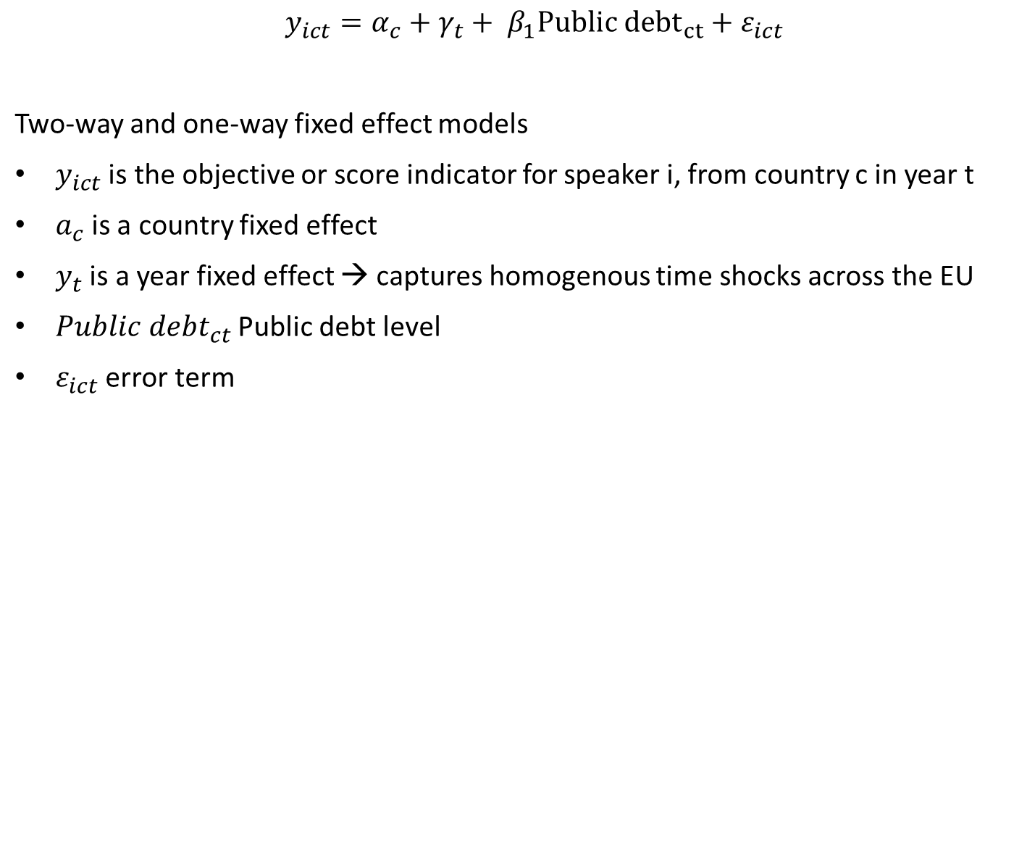
Econometric Model
$y_{ict}=α_{c}+γ_{t}+ β_{1}Public {debt}_{ct}+ε_{ict}$ Two-way and one-way fixed effect models $y_{ict}$ is the objective or score indicator for speaker i, from country c in year t $a_{c}$is a country fixed effect $y_{t}$ is a year fixed effect → captures homogenous time shocks across the EU $Public debt_{ct}$ Public debt level $ε_{ict}$ error term
Notes:
Here we follow the literature

Slide 9
Objectives over Time: Coverage LLM

Slide 10
Coverage of Selected Objectives by Country LLM

Slide 11
Coverage of Selected Objectives By Speaker LLM (Since 2015)
Note: Speaker with more than 40 speeches between 2014-2024

Slide 12
Summary Preliminary Regression result – Public debt and Objectives
Cross country correlation between higher public debt and secondary objectives
  Higher likelihood to mention secondary objective if state has higher public debt
Higher public debt correlates with more dovish position (robust to two-way fixed effects)

Slide 13
Project Outlook
Continous measure
  Split speeches in smaller parts
  Directly measure preferences continously with LLMs
Include individual characteristics
  Education, profession, age
  Individual fixed effects → how do individual central bankers change their positions
Validation + Robustness checks

Slide 14
conclusion
New measurement of ECB‘s primary and secondary objectives using LLMs
Revealed objective have become more diverse
Public debt and ECB objectives
Link between debt-to-GDP ratio and dovishness of national GC members (Two-way FE)
National presidents more likely to mention secondary objectives with higher debt-to-GDP ratio (Year FE)
  Most robust for distributional concerns (Two-way FE)

